Slide 1

Multi ESD Monitoring System Software for DSF602

Slide 2
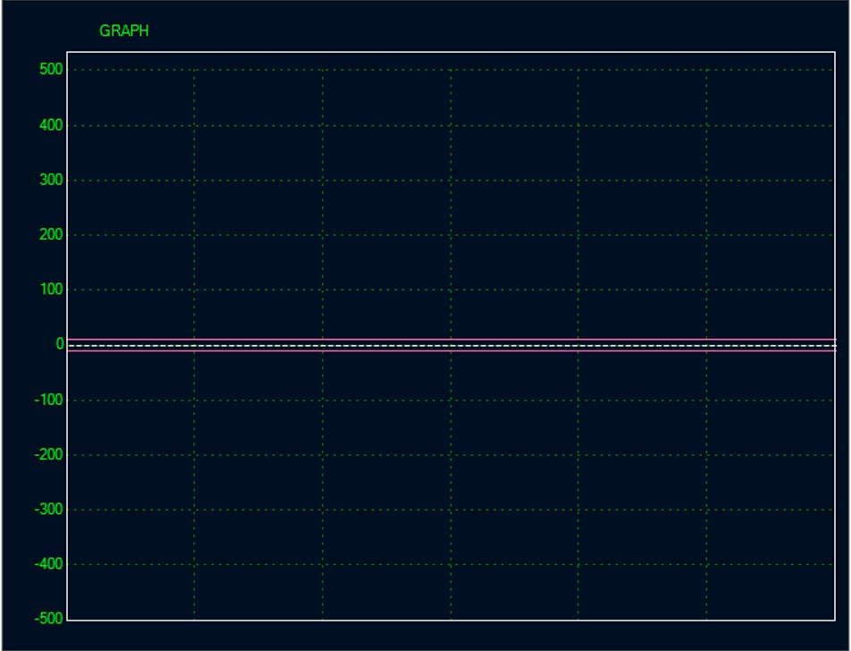
1. ESD Field meter function
Static Voltage by ESD Sensor
ESD Charge
ESD Charge
Abnormal Discharge
Abnormal discharge

Slide 3
2. Ion Balance monitoring function for Ionizer
With plate onto the ESD Sensor
Induction by Ionizer
Natural Unbalance

Slide 4
3. Decay check monitoring function for Ionizer
With plate onto the ESD Sensor and Charge unit
Normal Decay
No Decay
Normal Decay

Slide 5
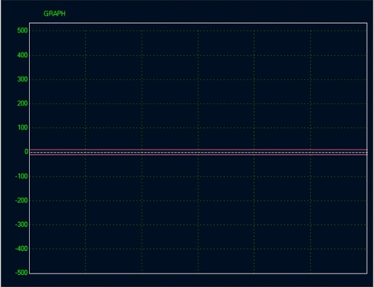

Multi ESD Monitoring System Software for DSF602
SETTING
LOG IN
MODE
LABEL
ALARM
MAP
NETWORK
LANGUAGE
DATA
Block 1
CH1
PEAK: +426V / -8V
DECAY: --- sec
DECAY TO: 100V
ALARM
CHARGE
DATA
MAC address is input into each CONTROL PCB
ON
OFF
LOCATION
Block 1
CH3
CH6
Block 2
Block 3
Block 4
Block 5
Block 6
CH4
PEAK: +501V
CH7
Block 7
Block 8
CH2
PEAK: +426V / -8V
DECAY: 1.3 sec
DECAY TO: 100V
ALARM
CHARGE
DATA
ON
OFF
Block 9
Block 10
VIEW
CH5
CH8
Version. 770220
Real ESD Solutions & New Technology

Slide 6
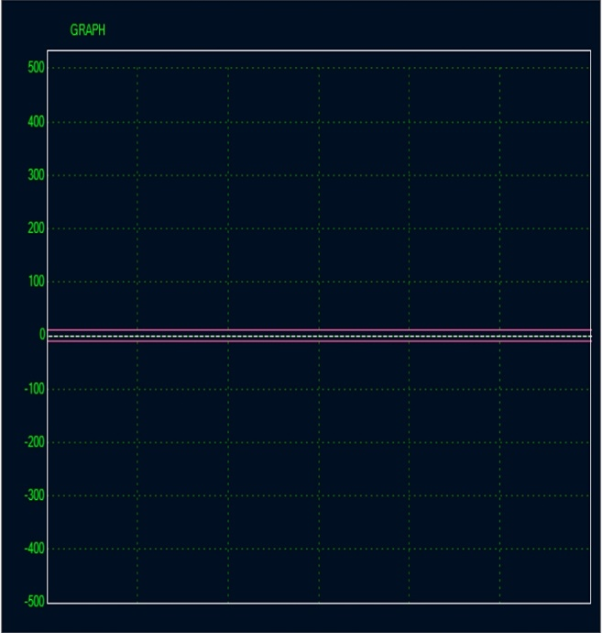
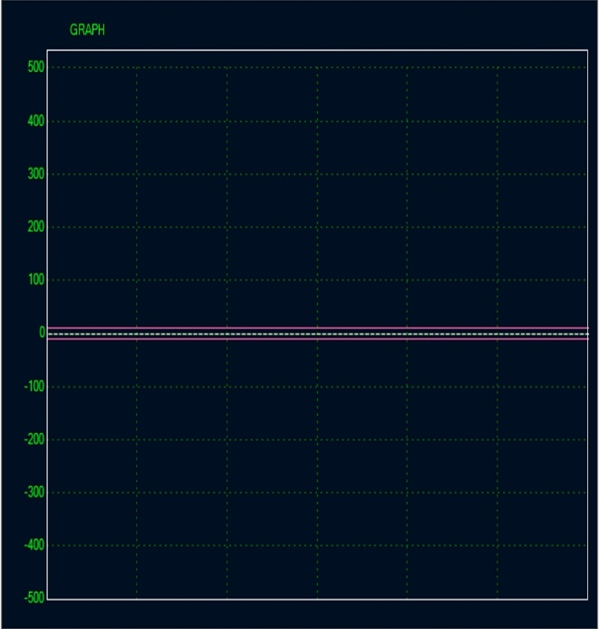
Multi ESD Monitoring System Software for DSF602
SETTING
LOG IN
MODE
LABEL
ALARM
MAP
NETWORK
LANGUAGE
DATA
Block 1
CH1
CH2
CH3
CH4
PEAK: +501V
LOCATION
Block 1
Block 2
Block 3
Block 4
Block 5
Block 6
Block 7
Block 8
CH5
CH6
CH7
CH8
Block 9
Block 10
VIEW
Version. 770220
Real ESD Solutions & New Technology

Slide 7
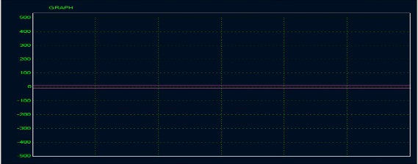
Multi ESD Monitoring System Software for DSF602
SETTING
LOG IN
MODE
LABEL
ALARM
MAP
NETWORK
LANGUAGE
DATA
Block 1
PEAK: +426V / -8V
DECAY: 1.3 sec
DECAY TO: 100V
ALARM
CHARGE
DATA
CH2
LOCATION
CH1
ON
OFF
Block 1
Block 2
CH3
Block 3
Block 4
Block 5
CH4
PEAK: +501V
Block 6
Block 7
CH5
Block 8
Block 9
Block 10
CH6
VIEW
CH7
CH8
Version. 770220
Real ESD Solutions & New Technology

Slide 8
Multi ESD Monitoring System Software for DSF602
Block 1
No.1
PEAK: +426V / -8V
DECAY: 1.3 sec
DECAY TO: 100V
ALARM
CHARGE
DATA
ON
OFF
SETTING
LOG IN
MODE
LABEL
ALARM
MAP
NETWORK
LANGUAGE
DATA
No.3
No.6
LOCATION
Block 1
Block 2
Block 3
Block 4
PEAK: +501V
Block 5
No.4
No.7
Block 6
No.2
PEAK: +426V / -8V
DECAY: 1.3 sec
DECAY TO: 100V
Block 7
ALARM
CHARGE
DATA
ON
OFF
Block 8
Block 9
Block 10
No.5
No.8
VIEW
Version. 770220
Real ESD Solutions & New Technology

Slide 9
Multi ESD Monitoring System Software for DSF602
Show “Block name”
Block 1
CH4
PEAK: +501V
SETTING
LOG IN
MODE
LABEL
ALARM
MAP
NETWORK
LANGUAGE
DATA
CH3
CH6
LOCATION
Block 1
Block 2
Block 3
CH1
PEAK: +426V / -8V
DECAY: 1.3 sec
DECAY TO: 100V
ALARM
CHARGE
DATA
Each wave can move on the screen.
Main 2 wave can be shown as big size.
With clicking the wave as alarm, automatically shows as big size.
Alarm(ON/OFF) button, CHARGE button, DATA button, Voltage scroll, Time scroll shows only big size
ON
OFF
Block 4
Block 5
No.7
Block 6
CH2
PEAK: +426V / -8V
DECAY: 1.3 sec
DECAY TO: 100V
Block 7
ALARM
CHARGE
DATA
ON
OFF
Block 8
Block 9
Block 10
No.5
No.8
VIEW
View mode
1: Big size x 2＋ Small size x 6
2: Same size x 8
3: Big size x 1 ＋ Small size x 7
Version. 770220
Real ESD Solutions & New Technology

Slide 10
Wave details
DECAY TIME indication (After Charge command, check the Peak voltage, and show the decay time by software.
Decayed voltage.
Set by Software.
(Initial voltage is 100V)
Setting of Alarm ON/OFF
Show light color that is set now.
Alarm set from Setting.
Peak voltage shows for ＋ / -
Monitoring point (Sensor address) number
[LABEL]: can be changed actual name
Charge command button.
When start to charge, show [You start to charge, OK?] for confirmations message.
CH1
PEAK: +426V / -8V
DECAY: 1.3 sec
DECAY TO: 100V
ALARM
CHARGE
DATA
ON
OFF
Data output: Show the data file that shows now.
Alarm (Threshhold) setting bar.
Only as +/- Absolute value (絶対値).
Voltage rang bar.
With sliding, can change the range.
Initial value is feed back by sensor (2KV)
Time range adjust bar
With sliding, can change the range .
Initial value is 30 seconds, Minimum is 5 seconds.

Slide 11
Tools
LOG IN: Initial setting(Voltage/Charging), Alarm set. Only authorized person can set with pass word.
Initial Pass: 0000
TOOL BAR display as multi task operation.
Location: Show as Each Control PCB as each BLOCK with 8 sensors.
Reason: Easy to control and operation.
Maximum 10 PCM as 80 sensors.
The name of Each BLOCK can be changed by LABEL Command. (文字数制限)
Set the Mode: Measure/Charge select.
MAC ID setting for each sensors.
LABEL: each LOCATION name, Measuring point(Sensor address) naming change.
As clicking, LOCATION name select mode.
LOCATION
The color of Block that is operating is different
Block 1
SETTING
Block 2
LOG IN
MODE
LABEL
ALARM
MAP
NETWORK
LANGUAGE
DATA
Block 3
Block 4
With RED colored as Alarm point.
ALARM setting button.
As clicking, show the view of LOCATION, and after select LOCATION, show the display each measuring points.
Block 5
Block 6
Block 7
Decay Setting: Decay voltage setting, Caution indication when Charging start. ON/OFF
Automode ( Auto Decay test as Fixed time)
Connecting with machine (ESDA evacuation)
Direct list of 80 points of sensor
Block 8
NETWORK Setting: IP address, etc
Open the data file.
Block 9
Block 10
ENGLISH/CHINESE
0 Reset (N/A for voltage mode)
Auto(time, date)/Manual

Slide 12
LOCATION Map
SETTING
LOG IN
MODE
LABEL
ALARM
MAP
NETWORK
LANGUAGE
DATA
Location (Block) | #1 | #2 | #3 | #4 | #5 | #6 | #7 | #8
Machine 1 | Loading 1 | Testing 1 | Unloading 1 | Ionizer #1 IB | Ionizer #1 Decay | Ionizer #2 IB | Ionizer #2 Decay | Ionizer #3 Decay
Machine 2 | Loading 2 | Testing 2 | Unloading 2 | Ionizer #4 IB | Ionizer #4 Decay | Ionizer #5 IB | Ionizer #5 Decay | Ionizer #6 Decay
Machine 3 | Loading 3 | Testing 3 | Unloading 3 | Ionizer #7 IB | Ionizer #7 Decay | Ionizer #8 IB | Ionizer #8 Decay | Ionizer #9 Decay
Machine 4 | Loading 4 | Testing 4 | Unloading 4 | Ionizer #10 IB | Ionizer #11 Decay | Ionizer #11 IB | Ionizer #11 Decay | Ionizer #12 Decay
Assembly line 1 | Ionizer #13 IB | Ionizer #13 Decay | Ionizer #14 IB | Ionizer #14 Decay | Ionizer #15 IB | Ionizer #15 Decay | Ionizer #16 Decay | Ionizer #17 Decay
Assembly line 2 | Operator 1 | IC tray 1 | Ionizer #18 Decay | Ionizer #19 IB | Ionizer #19 Decay | Ionizer #20 Decay | Ionizer #21 Decay | Ionizer #22 Decay
Test process 1 | Loading 5 | Testing 5 | Ionizer #23 IB | Ionizer #23 Decay | Ionizer #24 IB | Ionizer #24 Decay | Ionizer #25 Decay | Ionizer #26 Decay
Test Process 2 | Loading 6 | Testing 6 | Unloading 6 | Ionizer #27 IB | Ionizer #27 Decay | Ionizer #28 IB | Ionizer #28 Decay | Ionizer #29 Decay
Conveyer 1 | SMT Ionizer #1 IB | SMT Ionizer #1 Decay | SMT Ionizer #2 IB | SMT Ionizer #2 Decay | IC TEST Ionizer #3 IB | IC TEST Ionizer #4 IB | Cassette Ionizer #1 Decay | Cassette Ionizer #1 Decay
Conveyer 2 | Loading | Ionizer #1 IB | Ionizer #1 Decay | Ionizer #2 IB | Ionizer #2 Decay | Ionizer #3 Decay | Ionizer #2 Decay | Ionizer #3 Decay

Slide 13
Data output

Slide 14
Error Flow of Software
Assumed Error① Voltage Measuring Mode・IB Mode
Unable to measure
Sensor Issue
Sensor PCB
Sensor CH doesn’t set
Sensor Disconnected
Sensor PCB Disconnected
No Initial setting Complete
Cable Disconnected
PCB Cable Disconnected
Error 9
Sensor PCB
PCB Cable Disconnected
Not completed sensor CH setting
Sensor Issue or Disconnect
Cable disconnect
Available to Judgement?

Slide 15
Error Flow of Software
Assumed Error② Decay Mode
Unable calculation
Sensor Issue
Less Charging
Calculation issue
Voltage Leaking from Plate
減衰到達電位、設定電圧未到達(IB不良)
Powerful Ionizer around
印可以前電位大
Charging Issue
判定不能、by 印可 or Peak電位
Error 9
Abnormal Charging
除電機能確認不能
Sensor故障
判別可能？

